Slide 1

GUI Programming
with Java
Session 7
Frame Based GUI’s

Slide 2

We will look at…
  JInternalFrame

Slide 3
Many GUI’s applications simulate desktop environments by allowing multiple frames or windows to be displayed within a single root window.
These frames look and in many cases behave like those on our normal desktop even though the window manager associated with the desktop is not aware of them (they are internal to the application)
Typical examples include graphics applications, word processors, office applications etc.
In this session we will examine the methods for creating internal frame based applications.

Slide 4
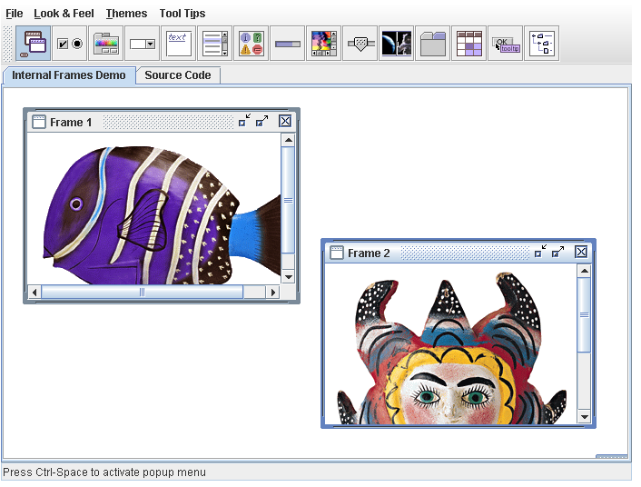
The above screenshot is from the swing demo we looked at in session 1.
It makes use of internal frames.

Slide 5
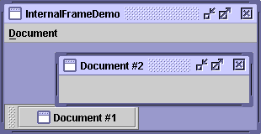
With the JInternalFrame class you can display a JFrame-like window within another window.
Usually, you add internal frames to a desktop pane. (using JDesktopPane)
The desktop pane, in turn, might be used as the content pane of a JFrame.

Slide 6
Lets now take a look at
InternalFrameDemo1.java
which accompanies this lecture.

Slide 7
We base our class on a JFrame. In other words, our application will consist of a JFrame that will in turn consist of a number of inner frames
We import some new libraries to allow us to make use of the internal frame and the desktop pane
import javax.swing.JInternalFrame;
import javax.swing.JDesktopPane;
import javax.swing.JFrame;

Slide 8
We begin by creating a JDesktopPane object
JDesktopPane desktop = new JDesktopPane();
This is simply a pane on which we can add content, only in this case it will be frames.

Slide 9
We then create an internal frame
JInternalFrame innerframe = new JInternalFrame("Internal Window" ,
true, //resizable
true, //closable
true, //maximizable
true);//iconifiable
When creating a frame we specify its title, weather it is resizable, closable, maximizable or iconifiable

Slide 10
Just like a standard JFrame, we can set the size and visibility and other properties of the JInternalFrame
innerframe.setSize(300,300);
innerframe.setVisible(true); //necessary as of 1.3
We then get the desktop to act as the content pane for the JFrame
setContentPane(desktop);

Slide 11
Most frame based applications use menu’s so lets expand our program and add a menu to it.
Lets now take a look at
InternalFrameDemo2.java
which accompanies this lecture.

Slide 12
You can see that the menu does not do much.
However the methods for adding menus are exactly the same as standard frames.
Remember that our program is based on a JFrame

Slide 13
A more complex example
Take a look at the program
InternalFrameDemo.java
It makes use of another class called
MyInternalFrame.java
This example allows us to create a series of new windows using a menu.

Slide 14
Rules of using Internal Frames
You must set the size of the internal frame.
  If you don't set the size of the internal frame, it will have zero size and thus never be visible. You can set the size using one of the following methods: setSize, pack, or setBounds.
As a rule, you should set the location of the internal frame.
  If you don't set the location of the internal frame, it will come up at 0,0 (the upper left of its container). You can use the setLocation or setBounds method to specify the upper left point of the internal frame, relative to its container.

Slide 15
Rules of using Internal Frames
To add components to an internal frame, you add them to the internal frame's content pane.
  This is exactly like the JFrame situation.
Dialogs that are internal frames should be implemented using JOptionPane or JInternalFrame, not JDialog.
  To create a simple dialog, you can use the JOptionPane showInternalXxxDialog methods.

Slide 16
Rules of using Internal Frames
You must add an internal frame to a container.
  If you don't add the internal frame to a container (usually a JDesktopPane), the internal frame won't appear.
You need to call show or setVisible on internal frames.
  Internal frames are invisible by default. You must invoke setVisible(true) or show() to make them visible.

Slide 17
Internal frames fire internal frame events, not window events.
  Handling internal frame events is almost identical to handling window events.
  Visit http://java.sun.com/docs/books/tutorial/uiswing/events/internalframelistener.html for more information on internal frame events.

Slide 18
For more information on internal frames visit
http://java.sun.com/docs/books/tutorial/uiswing/components/internalframe.html#construct

Slide 19
Some useful methods
setJMenuBar
you can add menus to internal frames
setLocation
position the frame
setBounds
Explicitly set the size and location of the internal frame.
setSize
Explicitly set the size of the internal frame.
moveToFront() or moveToBack()
If the internal frame's parent is a layered pane such as a desktop pane,
moves the internal frame to the front or back (respectively) of its layer.

Slide 20
Some useful methods
setClosed(boolean)
Set or get whether the internal frame is currently closed. The argument to setClosed must be true.
setFrameIcon(Icon)
Set the icon displayed in the title bar of the internal frame (usually in the top-left corner).
JInternalFrame[] getAllFrames()
Returns all JInternalFrame objects that the desktop contains.

Slide 21
Event Handling for Internal Frames
An InternalFrameListener is similar to a WindowListener.
Like the window listener, the internal frame listener listens for events that occur when the "window" has been shown for the first time, disposed of, iconified, deiconified, activated, or deactivated.
Take a look at InternalFrameEventDemo.java for a sample of how we can handle internal frame events.

Slide 22
Lab Exercises for Session 6
Task 7-1
Write a class that creates a window with an internal frame which has the following properties
  Internal Frame Title: My First Internal Frame
  Size: 640 X 480
  Location: 10 pixels in from the top and left of the parent frame
  Allow Resize: No
Hint: Use Java Documentation

Slide 23
Lab Exercises for Session 6
Task 7-2
Write a class that adds a file menu to the internal frame from Task 6-1.
The menu should have the following items
New
Save
Close
Task 7-3
Write a class that uses a for loop to create five windows on screen.

Slide 24
END OF SESSION

